Slide 1

8085 Interrupts
LAKSHMI.B.E.

Slide 2
Interrupts
Interrupt is a process where an external device can get the attention of the microprocessor.
  The process starts from the I/O device
  The process is asynchronous.
  TYPES OF INTERRUPT:
  SOFTWARE AND HARDWARE
  VECTORED AND MASKABLE AND
  NON VECTORED NON MASKABLE
LAKSHMI.B.E.

Slide 3
Classification of Interrupts
  Interrupts can be classified into two types:
    Maskable Interrupts (Can be delayed or Rejected)
    Enable Or Disable By EI And DI Instruction
    Non-Maskable Interrupts (Can not be delayed or Rejected)
Interrupts can also be classified into:
    Vectored (the address of the service routine is hard-wired)
    Non-vectored (the address of the service routine needs to be supplied externally by the device)
LAKSHMI.B.E.

Slide 4
Interrupts
An interrupt is considered to be an emergency signal that may be serviced.
  The Microprocessor may respond to it as soon as possible.
What happens when MP is interrupted ?
  When the Microprocessor receives an interrupt signal, it suspends the currently executing program and jumps to an Interrupt Service Routine (ISR) to respond to the incoming interrupt.
  Each interrupt will most probably have its own ISR.
LAKSHMI.B.E.

Slide 5
Responding to Interrupts
Responding to an interrupt may be immediate or delayed depending on whether the interrupt is maskable or non-maskable and whether interrupts are being masked or not.
There are two ways of redirecting the execution to the ISR depending on whether the interrupt is vectored or non-vectored.
  Vectored: The address of the subroutine is already known to the Microprocessor
  Non Vectored: The device will have to supply the address of the subroutine to the Microprocessor
LAKSHMI.B.E.

Slide 6
The 8085 Interrupts
Interrupt name | Maskable | Vectored | VECTOR ADDRESS
TRAP | No | Yes | 0024H
RST 7.5 | Yes | Yes | 003CH
RST 6.5 | Yes | Yes | 0034H
RST 5.5 | Yes | Yes | 002CH
INTR | Yes | No | --

Slide 7
The 8085 Interrupts
When a device interrupts, it actually wants the MP to give a service which is equivalent to asking the MP to call a subroutine. This subroutine is called ISR (Interrupt Service Routine)
The ‘EI’ instruction is a one byte instruction and is used to Enable the non-maskable interrupts.
The ‘DI’ instruction is a one byte instruction and is used to Disable the non-maskable interrupts.
The 8085 has a single Non-Maskable interrupt.
  The non-maskable interrupt is not affected by the value of the Interrupt Enable flip flop.
LAKSHMI.B.E.

Slide 8
The 8085 Interrupts
The 8085 has 5 interrupt inputs.
  The INTR input.
    The INTR input is the only non-vectored interrupt.
    INTR is maskable using the EI/DI instruction pair.
  RST 5.5, RST 6.5, RST 7.5 are all automatically vectored.
    RST 5.5, RST 6.5, and RST 7.5 are all maskable.
  TRAP is the only non-maskable interrupt in the 8085
    TRAP is also automatically vectored
LAKSHMI.B.E.

Slide 9
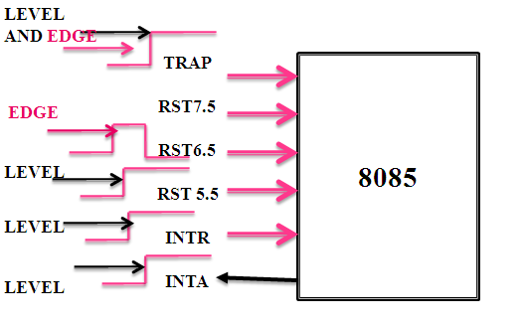
8085 Interrupts
LAKSHMI.B.E.

Slide 10
Interrupt Vectors and the Vector Table
An interrupt vector is a pointer to where the ISR is stored in memory.
All interrupts (vectored or otherwise) are mapped onto a memory area called the Interrupt Vector Table (IVT).
  The IVT is usually located in memory page 00 (0000H - 00FFH).
  The purpose of the IVT is to hold the vectors that redirect the microprocessor to the right place when an interrupt arrives.
LAKSHMI.B.E.

Slide 11
The 8085 Non-Vectored Interrupt Process
The interrupt process should be enabled using the EI instruction.
The 8085 checks for an interrupt during the execution of every instruction.
If INTR is high, MP completes current instruction, disables the interrupt and sends INTA (Interrupt acknowledge) signal to the device that interrupted
INTA allows the I/O device to send a RST instruction through data bus.
Upon receiving the INTA signal, MP saves the memory location of the next instruction on the stack and the program is transferred to ‘call’ location (ISR Call) specified by the RST instruction
LAKSHMI.B.E.

Slide 12
The 8085 Non-Vectored Interrupt Process
Microprocessor Performs the ISR.
ISR must include the ‘EI’ instruction to enable the further interrupt within the program.
RET instruction at the end of the ISR allows the MP to retrieve the return address from the stack and the program is transferred back to where the program was interrupted.
LAKSHMI.B.E.

Slide 13
The 8085 Maskable/Vectored Interrupts
The 8085 has 4 Masked/Vectored interrupt inputs.
  RST 5.5, RST 6.5, RST 7.5
    They are all maskable.
    They are automatically vectored according to the following table:
      The vectors for these interrupt fall in between the vectors for the RST instructions. That’s why they have names like RST 5.5 (RST 5 and a half).
Interrupt | Vector
RST 5.5 | 002CH
RST 6.5 | 0034H
RST 7.5 | 003CH
LAKSHMI.B.E.

Slide 14
Masking RST 5.5, RST 6.5 and RST 7.5
These three interrupts are masked at two levels:
  Through the Interrupt Enable flip flop and the EI/DI instructions.
    The Interrupt Enable flip flop controls the whole maskable interrupt process.
  Through individual mask flip flops that control the availability of the individual interrupts.
    These flip flops control the interrupts individually.
LAKSHMI.B.E.

Slide 15
Maskable Interrupts and vector locations
RST7.5 Memory
RST 7.5
M 7.5
RST 6.5
M 6.5
RST 5.5
M 5.5
INTR
Interrupt
Enable
Flip Flop
** See Fig 12.5 of the Text Book for a detailed look
LAKSHMI.B.E.

Slide 16
The 8085 Maskable/Vectored Interrupt Process
The interrupt process should be enabled using the EI instruction.
The 8085 checks for an interrupt during the execution of every instruction.
If there is an interrupt, and if the interrupt is enabled using the interrupt mask, the microprocessor will complete the executing instruction, and reset the interrupt flip flop.
The microprocessor then executes a call instruction that sends the execution to the appropriate location in the interrupt vector table.
LAKSHMI.B.E.

Slide 17
The 8085 Maskable/Vectored Interrupt Process
When the microprocessor executes the call instruction, it saves the address of the next instruction on the stack.
The microprocessor jumps to the specific service routine.
The service routine must include the instruction EI to re-enable the interrupt process.
At the end of the service routine, the RET instruction returns the execution to where the program was interrupted.
LAKSHMI.B.E.

Slide 18
Manipulating the Masks
The Interrupt Enable flip flop is manipulated using the EI/DI instructions.
The individual masks for RST 5.5, RST 6.5 and RST 7.5 are manipulated using the SIM instruction.
  This instruction takes the bit pattern in the Accumulator and applies it to the interrupt mask enabling and disabling the specific interrupts.
LAKSHMI.B.E.

Slide 19
How SIM Interprets the Accumulator
7
6
5
4
3
2
1
0
SDO
SDE
XXX
R7.5
MSE
M7.5
M6.5
M5.5
Serial Data Out
RST5.5 Mask
}
RST6.5 Mask
0 - Available
1 - Masked
RST7.5 Mask
Mask Set Enable
0 - Ignore bits 0-2
1 - Set the masks according
to bits 0-2
Enable Serial Data
0 - Ignore bit 7
1 - Send bit 7 to SOD pin
Not Used
Force RST7.5 Flip Flop to reset
LAKSHMI.B.E.

Slide 20
SIM and the Interrupt Mask
Bit 0 is the mask for RST 5.5
Bit 1 is the mask for RST 6.5
Bit 2 is the mask for RST 7.5.
    If the mask bit is 0, the interrupt is available.
    If the mask bit is 1, the interrupt is masked.
LAKSHMI.B.E.

Slide 21
Bit 3 (Mask Set Enable - MSE) is an enable for setting the mask.
    If it is set to 0 the mask is ignored and the old settings remain.
    If it is set to 1, the new setting are applied.
    The SIM instruction is used for multiple purposes and not only for setting interrupt masks.
      It is also used to control functionality such as Serial Data Transmission.
      Therefore, bit 3 is necessary to tell the microprocessor whether or not the interrupt masks should be modified
LAKSHMI.B.E.

Slide 22
SIM and the Interrupt Mask
The RST 7.5 interrupt is the only 8085 interrupt that has memory.
  If a signal on RST7.5 arrives while it is masked, a flip flop will remember the signal.
  When RST7.5 is unmasked, the microprocessor will be interrupted even if the device has removed the interrupt signal.
  This flip flop will be automatically reset when the microprocessor responds to an RST 7.5 interrupt.
Bit 4 of the accumulator in the SIM instruction allows explicitly resetting the RST 7.5 memory even if the microprocessor did not respond to it.
Bit 5 is not used by the SIM instruction
LAKSHMI.B.E.

Slide 23
Using the SIM Instruction to Modify the Interrupt Masks
Example: Set the interrupt masks so that RST5.5 is enabled, RST6.5 is masked, and RST7.5 is enabled.
  First, determine the contents of the accumulator
- Enable 5.5 bit 0 = 0
- Disable 6.5 bit 1 = 1
- Enable 7.5 bit 2 = 0
- Allow setting the masks bit 3 = 1
- Don’t reset the flip flop bit 4 = 0
- Bit 5 is not used bit 5 = 0
- Don’t use serial data bit 6 = 0
- Serial data is ignored bit 7 = 0
M7.5
M6.5
SDO
MSE
M5.5
SDE
R7.5
XXX
0
0
0
0
1
0
1
0
Contents of accumulator are: 0AH
EI ; Enable interrupts including INTR
MVI A, 0A ; Prepare the mask to enable RST 7.5, and 5.5, disable 6.5
SIM ; Apply the settings RST masks
LAKSHMI.B.E.

Slide 24
Triggering Levels
RST 7.5 is positive edge sensitive.
    When a positive edge appears on the RST7.5 line, a logic 1 is stored in the flip-flop as a “pending” interrupt.
    Since the value has been stored in the flip flop, the line does not have to be high when the microprocessor checks for the interrupt to be recognized.
    The line must go to zero and back to one before a new interrupt is recognized.
RST 6.5 and RST 5.5 are level sensitive.
    The interrupting signal must remain present until the microprocessor checks for interrupts.
LAKSHMI.B.E.

Slide 25
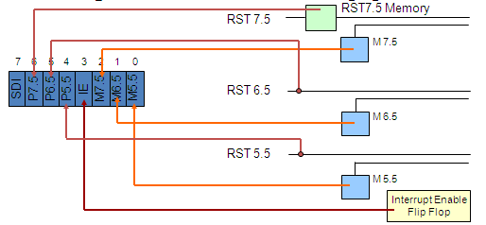
Determining the Current Mask Settings
RIM instruction: Read Interrupt Mask
  Load the accumulator with an 8-bit pattern showing the status of each interrupt pin and mask.
LAKSHMI.B.E.

Slide 26
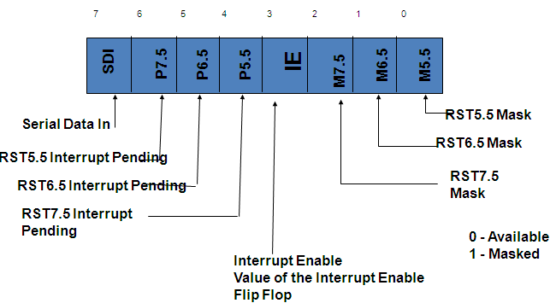
RIM sets the Accumulator’s different bits
LAKSHMI.B.E.

Slide 27
The RIM Instruction and the Masks
Bits 0-2 show the current setting of the mask for each of RST 7.5, RST 6.5 and RST 5.5
    They return the contents of the three mask flip flops.
    They can be used by a program to read the mask settings in order to modify only the right mask.
Bit 3 shows whether the maskable interrupt process is enabled or not.
    It returns the contents of the Interrupt Enable Flip Flop.
    It can be used by a program to determine whether or not interrupts are enabled.
LAKSHMI.B.E.

Slide 28
The RIM Instruction and the Masks
Bits 4-6 show whether or not there are pending interrupts on RST 7.5, RST 6.5, and RST 5.5
    Bits 4 and 5 return the current value of the RST5.5 and RST6.5 pins.
    Bit 6 returns the current value of the RST7.5 memory flip flop.
Bit 7 is used for Serial Data Input.
    The RIM instruction reads the value of the SID pin on the microprocessor and returns it in this bit.
LAKSHMI.B.E.

Slide 29
Pending Interrupts
Since the 8085 has five interrupt lines, interrupts may occur during an ISR and remain pending.
  Using the RIM instruction, it is possible to can read the status of the interrupt lines and find if there are any pending interrupts.
  See the example of the class
LAKSHMI.B.E.

Slide 30
TRAP
TRAP is the only non-maskable interrupt.
  It does not need to be enabled because it cannot be disabled.
It has the highest priority amongst interrupts.
It is edge and level sensitive.
  It needs to be high and stay high to be recognized.
  Once it is recognized, it won’t be recognized again until it goes low, then high again.
TRAP is usually used for power failure and emergency shutoff.
LAKSHMI.B.E.

Slide 31
Issues in Implementing INTR Interrupts
How long must INTR remain high?
  The microprocessor checks the INTR line one clock cycle before the last T-state of each instruction.
  The INTR must remain active long enough to allow for the longest instruction.
  The longest instruction for the 8085 is the conditional CALL instruction which requires 18 T-states.
Therefore, the INTR must remain active for 17.5 T-states.
If f= 3MHZ then T=1/f and so, INTR must remain active for [ (1/3MHZ) * 17.5 ≈ 5.8 micro seconds].
LAKSHMI.B.E.

Slide 32
Issues in Implementing INTR Interrupts
How long can the INTR remain high?
  The INTR line must be deactivated before the EI is executed. Otherwise, the microprocessor will be interrupted again.
  Once the microprocessor starts to respond to an INTR interrupt, INTA becomes active (=0).
Therefore, INTR should be turned off as soon as the INTA signal is received.
LAKSHMI.B.E.

Slide 33
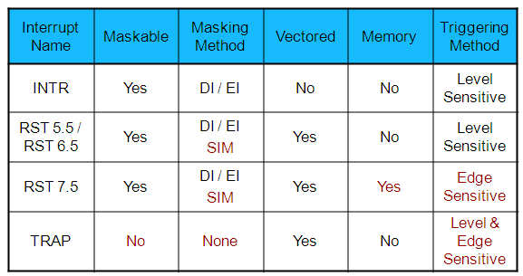
The 8085 Interrupts

Slide 34
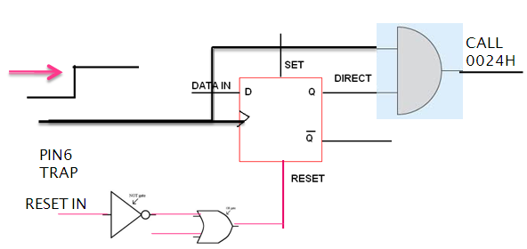

Slide 35
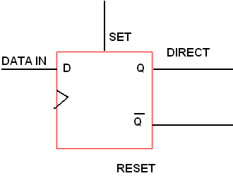



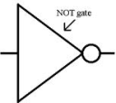
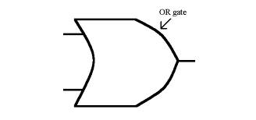
PIN 7
RST 7.5
M7.5’
R 7.5
RST 7.5 ACKNOWLEDGEMENT
MSE

Slide 36
The End
… Thank you …

